Slide 1

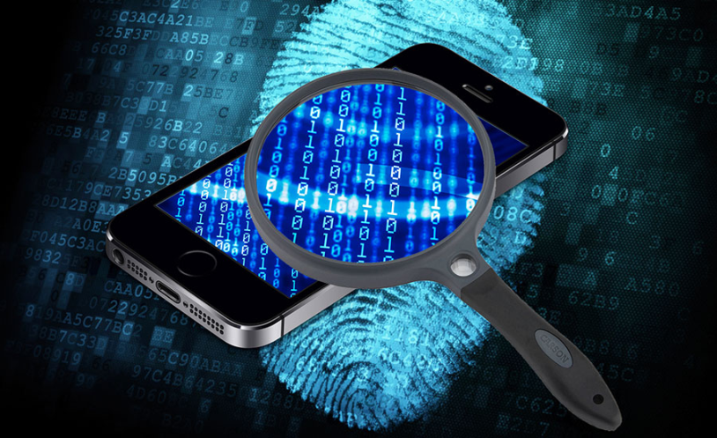
Mobile Phone Security
Dr. Digvijaysinh Rathod
Associate Professor & Associate Dean
School of Cyber Security and Digital Forensics
National Forensic Sciences University with status of Institution of National Importance
digvijay.rathod@gfsu.edu.in

Slide 2
Tools and Vuln Application
Tools and Vulnerable Android Application for Android Application Security PenTesting
Dr. Digvijaysinh Rathod

Slide 3
Tools and Vuln Application
Why Do we need tools and Vulnerable Application ?
OWASP TOP 10
Vulnerable Applicaiton
Tools and Technology to test it
Dr. Digvijaysinh Rathod

Slide 4
OWASP mobile top 10 security risks
M1 - Improper Platform Usage
M2 - Insecure Data Storage
M3 - Insecure Communication
M4 - Insecure Authentication
M5 - Insufficient Cryptography
M6 - Insecure Authorization
M7 - Client Code Quality
M8 - Code Tampering
M9 - Reverse Engineering
M10 - Extraneous Functionality
Dr. Digvijaysinh Rathod

Slide 5
Tools and Vuln Application
Android Vulnerable Application
DIVA - Damn insecure and vulnerable App
InsecureBankv2
OWASP GoatDroid
OWASP Security Shepherd
Dr. Digvijaysinh Rathod

Slide 6
Tools and Vuln Application
Security Pen-Testing
Manual Security Pen-Testing – Through interface or interceptions
Burp Suit
Drozer
Mobsf
Dr. Digvijaysinh Rathod

